Slide 1
UNIT 11:
Customer Segmentation &
Dynamic Pricing

Slide 2
Customer Segmentation & Dynamic Pricing
Airlines
Movie Theatres
Sports Teams
Barber Shops
Credit Card/Retail Banking Companies

Slide 3
Catalina Marketing Targeted Offers Offers are 10X More Likely to be Acted Upon When Backed Up by Analytics

Slide 5
Saving Harrah’s from Bankruptcy Page 132-133 (COA) (Now Caesar’s Entertainment) http://www.bloomberg.com/news/articles/2010-08-06/loveman-plays-new-purely-empirical-game-as-harrah-s-ceo

Slide 6
Harrah’s Downward Death Spiral
Losing Customers
Decreasing Market Share
Decreasing Revenues and Profits
Failed to meet targets from 1991-97
Aging Properties
Next Stop: Chapter 11 or 7
Analytics to the Rescue!

Slide 7
Harrah’s Executive Leadership Profile
Gary Loveman, PhD (Economics), MIT
Harvard Business School (HBS) Professor
Consultant & Speaker
Harrah’s Consultant, COO, then CEO
An academic theoretician who made the transition to corporate leadership
Paper: "Putting the Service-Profit Chain to Work”
The paper focused on the relationship between company profits and customer loyalty, and the importance of rewarding employees who interact with customers

Slide 8


Harrah’s Near Death Experience
Market Share Growth
36% (1998) 43% (2004)
Same Store Sales Gains 23/24 Quarters
Failed to Meet Revenue & Profit (1991-97)

Slide 9



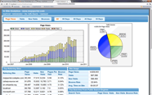












Analytics Architecture
Third Party Demographic Data, e.g., ACXIOM, Experian, KBMG
Customer Intelligence Analytics
Engines
(SAS, R)
Check-in
Casino
Demo- Psycho-graphics
Buying Behaviors, Choices, Habits
Patterns, Preferences
Propensity-to-Consume
Customer Lifetime Value
Rating or Score
Restaurant
& Bar
NET
Customer Profile
Retail & Mall
Data Warehouse
Customer Segment
Pool &
Spa
Customer Value
“Rating” or
“Score”
Mobile Advertising, Marketing,
Promotion Optimization
Shows
Patron Management System
$
Customized “Comps”
$
Dynamic Pricing, Revenue &
Capacity Optimization

Slide 10












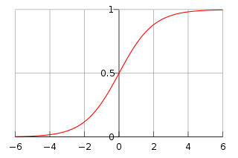



Analytics Architecture Flow
Customer
Data Warehouse or Data Mart
ETL
ODS
Source Systems
Business Problems or Questions
Cloud
Hosting
Results, Answers, Conclusions,
Recommendations,
Patterns, Trends,
Forecasts, Outcomes,
Decision Options
Decision Makers
$
Analytical Models

Slide 12
Analytics Executive Profile - Gary Loveman
“I am purely empirical”
“I see my Customers as a set of probabilities wrapped in human flesh” ;)
”I am not attached to any romantic notion of how this business should be run. I am only driven where the evidence takes me.” (Let the data speak!)
Gary’s Method of Customer Profiling – Segmentation
Gender & Age – Female & 50+ (Most lucrative demographic)
Lots of “Small Fry”
Not a few “Whales”
Games Played & Amount Wagered
Demographics
Where we live
What we do (leisure activities & how we make a living)
Income level

Slide 13
Analytics Executive Profile - Gary Loveman
“Mathematics is the language of logical expression and my mind works very logically. I have found in the casino business that is a great help most of the time.”
No HiPPOs allowed!
No managing by gut instinct
Built Harrah’s from 15 regional casinos to 39 in the US and 13 overseas
“My sort of logic excels at things like acquisitions or expansions or developments where I can look at the numbers and make it a defined, deductive problem”
Acquired World Series of Poker, Binion’s Horseshoe, Caesars, Imperial Palace, Planet Hollywood Resort & Casino, and golf course in Macau (world’s most lucrative market)

Slide 14
Analytics Executive Profile - Gary Loveman
Customer Targeting
Whales vs. Grandma & Grandpa
Customer Database
Targeted Offers based on demographic and gaming transactional history
Come-back soon inducements
Gaming revenue accounted for 80% of Harrah’s $9B revenue vs 45% industry
Food, beverage, retail, conferences, trade shows now account for more revenue than gaming since the economic crash in 2008-9

Slide 15
Analytics Executive Profile - Gary Loveman
Sometimes the numbers alone fail Loveman in his decision-making
He passed on buying Macau gaming license for $900M (one of only six available)
“There are two scarce resources in Macau; land and gaming licenses”
“The quantification took me in the opposite direction. You had to have a kind of intuitive courage, and I am not well-suited to those kinds of decisions.”
“Big mistake. I was wrong, I was really wrong.”
Macau is now the world’s largest gaming market
Las Vegas Sands, Wynn Resorts are now making more money there than in Vegas
Loveman spent $600M on a Macau golf course, in hopes of getting a gaming license later
“I try to be self-reflective of the fact that this is a short-coming of mine. I am trying to address that vulnerability by asking myself over and over again if I am over-thinking the problem. Am I missing something?”

Slide 16
Analytics Executive Profile - Gary Loveman
Harrah’s Total Rewards loyalty program enabled annual double-digit growth for 5-years in a row 2003-7
Far more profitable to retain loyal, repeat customers rather than have to market to and secure new customers
Paper: "Putting the Service-Profit Chain to Work” (1994)
The paper focused on the relationship between company profits and customer loyalty, and the importance of rewarding employees who interact with customers
Loveman pioneered the use of analytics in casinos, and quantified the link between happier customers and more profitable companies

Slide 17
Analytics Executive Profile - Gary Loveman
Casinos are largely a commodity business with little opportunity for differentiation between slot machines and gaming tables
Customer service and targeted marketing can make a significant difference in company performance
Total Rewards
_____ M members by 2010 with a $_____M annual IT budget
Described as the linchpin of Harrah’s success
The first loyalty program to be be applied across every casino in a company
Allowed for more accurate analysis of betting patterns
More equitable distribution of “comps”, i.e., free rooms, meals, show tickets

Slide 18
Analytics Executive Profile - Gary Loveman
Total Rewards led Loveman to a startling conclusion--- Harrah’s makes more money from elderly slot machine players than any other demographic, even high-roller multi-millionaire “whales”
“The slot player was the forgotten customer and the slot player offered us the biggest benefit in terms of data collection. I had to be willing to be unsexy in this. I can take you to a casino that would have a lot of young beautiful people in there and you would say, ‘Man, this is a happening place’. I could take you to another place where there are a lot of people who look like your parents. The latter would be more profitable than the former. My job is to make the latter.”
“The motor” of the Harrah’s juggernaut “is the database”

Slide 19
Analytics Executive Profile - Gary Loveman
Proprietary software assigns a value to each Total Rewards member
The expected amount of money you will lose per visit to a Harrah’s casino, based on the odds of the games you play, how long you play, and how much you wager
30-year old female slot player who has made 36 trips to Harrah’s Chicagoland casino, playing an average of 47 minutes losing $156 per visit; an active buffet customer, she will be enticed back with buffet and slot machine offers

Slide 21
The $529 Sucker
Gambled for exactly 8 hours 34 minutes
For example, sat down to play Pai Gow Poker at 1239pm, got up 1 hour and 6 minutes later; bought in for $800 and cashed out for $1300
Tracked where he had eaten, how much he had spent, where he shopped
Based on his age, gender, zip code and gaming prefereences, a value of $529 was assigned, i.e., how much he was expected to lose every time he visited a Harrah’s property
”You will be getting an attractive offer from us. Please keep playing.”

Slide 22
Gambling Industry & Ethics
According to the American Gaming Association, gambling is legal in 40 US states, and is a $240B industry employing 1.7M people contributing $8.5B in state and local tax revenues
Critics claim gambling leads to increased political corruption, compulsive gambling and increased crime rates
Gambling is viewed as another form of entertainment, no different than theater, concert & sporting events tickets or amusement parks

Slide 24
Harrah’s Cherokee Casino & Hotel A “Killer App” for Revenue Management

Slide 25
Revenue Management Overview
Invented in the airline industry in the mid-1980’s
Well-suited to industries characterized by
High fixed capital costs, e.g., airplanes, railroads, cruise ships, hotels
Low marginal costs, e.g., one more seat, one more berth, one more room
Commodity product that is difficult to differentiate from competitors
Competitive, dynamic pricing & demand elasticity as a function of price changes
RM’s purpose is to sell the right capacity to the right customer at the right price; setting differential prices for homogeneous capacity
Typically results in a 3-7% increase in revenue

Slide 26
Revenue Management Overview
Involves several problems that are solved using predictive and prescriptive techniques
Customer Segmentation
Fare Class Segmentation based on Product Utility Differentiation
Demand Forecasting by Product subject to Seasonality
Inventory Allocation Optimization by Product subject to Demand, Pricing

Slide 27
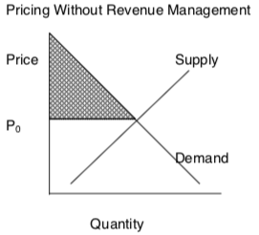
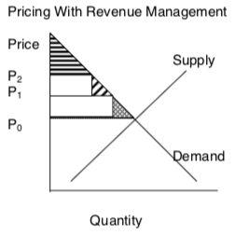
Revenue Management Overview

Slide 29
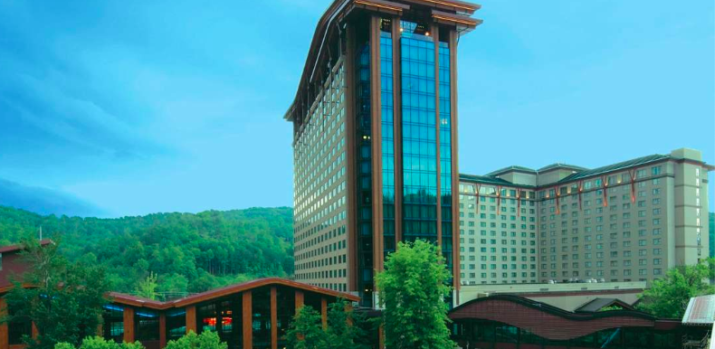
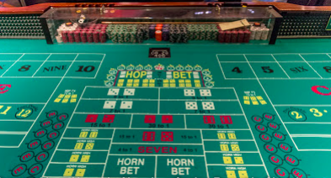
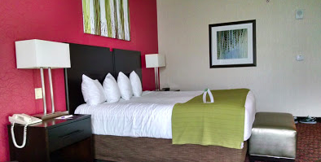
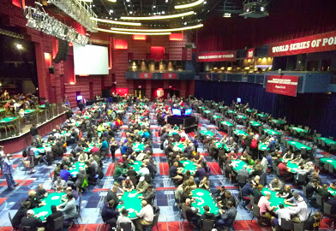
Harrah’s Cherokee Casino & Hotel

Slide 30
Harrah’s Cherokee Casino & Hotel
Located in Cherokee, NC
Owned & Operated by Eastern Band of the Cherokee Indians
Managed by Harrah’s (Total Rewards)
576 rooms
No alcohol served
Average room rate = $6/night
< 3-hour drive from Atlanta, SC, NC, TN metro areas
No direct competitors
98.6% occupancy rate Jan-Nov
60% margin on revenue
RM yields 15% more revenue

Slide 31
Mr. Smith tries to book a room…
Why is Mr. Smith’s request to book at room rejected even though 183 of the 576 rooms are still unreserved? But he is comped a room at the nearby Ramada?
Bets $2,000 per night netting the casino $140, probabilistically speaking

Slide 32
Mr. Smith tries to book a room…
Problem
How does a casino hotel maximize revenue and subsequently maximize profitability?
Why is Mr. Smith’s request to book at room rejected even though 183 of the 576 rooms are still unreserved? But he is comped a room at the nearby Ramada?
Bets $2,000 per night netting the casino $140, probabilistically speaking

Slide 33
Mr. Smith tries to book a room…
Problem
How does a casino hotel maximize revenue and subsequently maximize profitability?
Why is Mr. Smith’s request to book at room rejected even though 183 of the 576 rooms are still unreserved? But he is comped a room at the nearby Ramada?
Bets $2,000 per night netting the casino $140, probabilistically speaking
If N rooms are available, how can a system be devised to say “yes” to the N most profitable customers that wish to book on a given night, while declining the bookings of all other customers?

Slide 34
Mr. Smith tries to book a room…
Problem
How does a casino hotel maximize revenue and subsequently maximize profitability?
Why is Mr. Smith’s request to book at room rejected even though 183 of the 576 rooms are still unreserved? But he is comped a room at the nearby Ramada?
Bets $2,000 per night netting the casino $140, probabilistically speaking
Demand Forecast by Segment
Customer Segmentation
Maximize Revenue by Holding Out and Allocating Hotel Casino Room Capacity based on Ranked WTP Customer Segments
Willingness to Pay (WTP)
(or Gamble)
Allocate Capacity using Bid Price
Dynamic Inventory Capacity Management

Slide 35
Mr. Smith tries to book a room…
Problem
How does a casino hotel maximize revenue and subsequently maximize profitability?
Descriptive
Predictive
Prescriptive
Demand Forecast by Segment
Customer Segmentation
Maximize Revenue by Holding Out and Allocating Hotel Casino Room Capacity based on Ranked WTP Customer Segments
Willingness to Pay (WTP)
(or Gamble)
Allocate Capacity using Bid Price
Dynamic Inventory Capacity Management

Slide 36
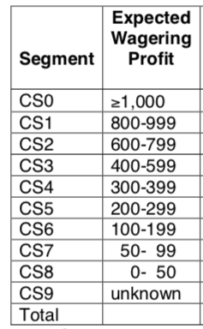
Casino Hotel Revenue Management
Customer Segmentation
Willingness to Pay (or Gamble)

Slide 37
Mr. Smith tries to book a room…
Problem
How does a casino hotel maximize revenue and subsequently maximize profitability?
If N rooms are available, how can a system be devised to say “yes” to the N most profitable customers that wish to book on a given night, while declining the bookings of all other customers?
Descriptive
Predictive
Prescriptive
Demand Forecast by Segment
Customer Segmentation
Maximize Revenue by Holding Out and Allocating Hotel Casino Room Capacity based on Ranked WTP Customer Segments
Willingness to Pay
(or Gamble)
Allocate Capacity using Bid Price
Dynamic Inventory Capacity Management

Slide 39
Casino Hotel Revenue Management
Cherokee utilizes Total Rewards Harrah’s customer loyalty program and transaction history system
Total Rewards racks customer play including games, money wagered, time played
83% of money wagered is “tracked play”
Revenue = total customer spend, including gambling, food, and hotel room
Average revenue per customer = $565/night
“Comps” include reduced price rooms, casino chips, valet service, meals, and other perks and amenities
Casinos and their customers incentives are perfectly aligned; gamble more, earn more points and perks, generate more profit
Descriptive
Customer Segmentation
Willingness to Pay
(or Gamble)

Slide 40
Customer Segment Demand Forecasting
Predictive
Unconstrained Demand by Customer Segment
Total Unconstrained Demand = Bookings Made + Booking Requests Denied
Any modern day machine learning method can be employed to forecast demand
Historically, time series methods, such as exponential smoothing provided an interpretable, accurate approach
Holt-Winters smoothing model was utilized in this case
Demand Forecast by Segment

Slide 41
Customer Segment Demand Forecasting
Predictive
Holt-Winters forecasts values for several demand trends
Base Demand and Demand Trends
Seasonality, e.g., annual, month, day of week
Special Events
Easily interpretable and reasonably accurate
Forecast demand for every Customer Segment, every day in the booking curve
Demand Forecast by Segment
Forecast _{i,t} = (Base _{i,t} + Trend _{i,t})(Seasonal Month _{i,t})(Seasonal Day _{i,t})(Event _{i,t})

Slide 42
Capacity Allocation Optimization – Bid Price
Prescriptive
Opportunity Cost of selling a unit of capacity to the wrong customer, i.e., one that will generate less revenue than another customer; the marginal value of one more unit of capacity
Average revenue of higher value customer segments multiplied by the probabilities that a higher value customer will request that unit of capacity in the future
Threshold limit for the amount of expected revenue a customer will generate per night
Dynamic Inventory Capacity Management
Maximize Revenue by Holding Out and Allocating Hotel Casino Room Capacity based on Ranked WTP Customer Segments
IF Bid Price > E(Revenue) THEN reject reservation request
IF Bid Price ≤ E(Revenue) THEN accept reservation request

Slide 43
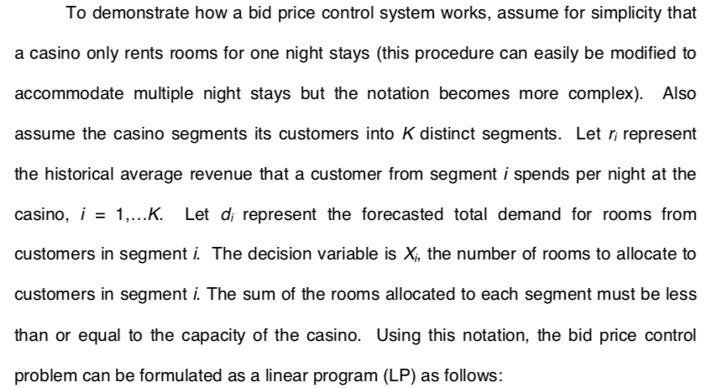
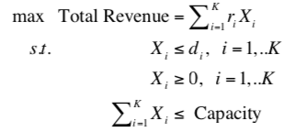
Capacity Allocation Optimization – LP Model
Prescriptive
Dynamic Inventory Capacity Management
Maximize Revenue by Holding Out and Allocating Hotel Casino Room Capacity based on Ranked WTP Customer Segments
Bid Price is the “shadow price” of one additional unity of capacity
Dual Variable on the Capacity Constraint

Slide 44
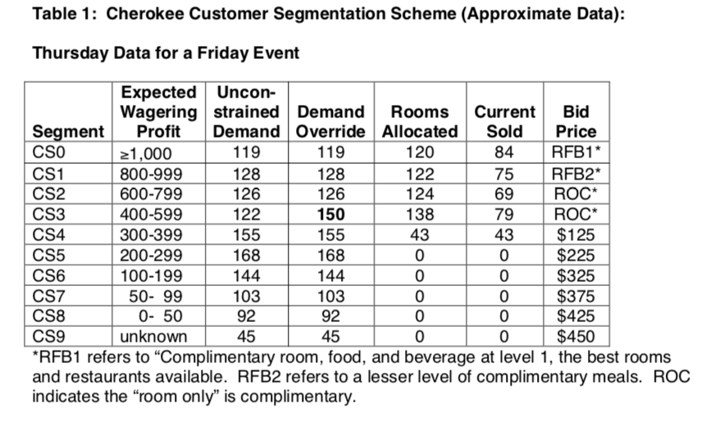
Demand Forecast by Segment
Allocate Capacity using Bid Price
Dynamic Inventory Capacity Management

Slide 45
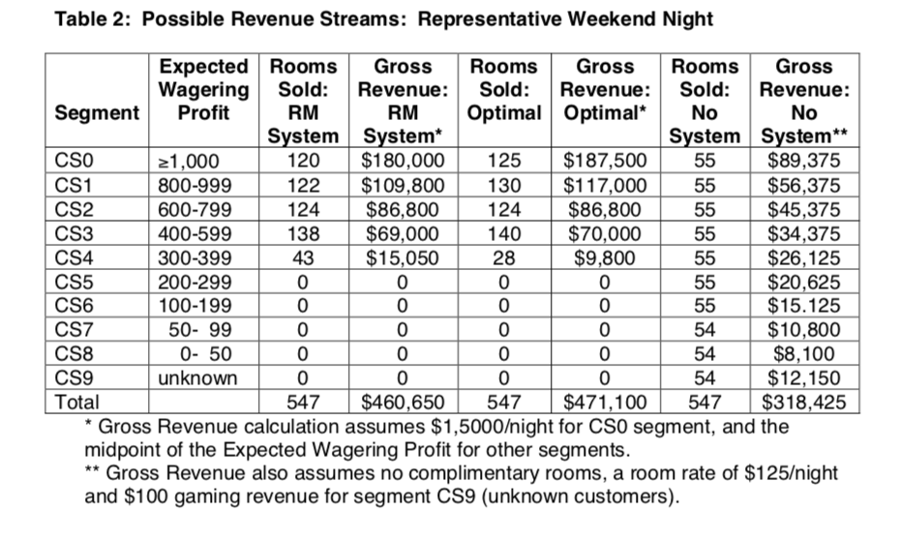
Maximize Revenue by Holding Out and Allocating Hotel Casino Room Capacity based on Ranked WTP Customer Segments

Slide 46
Maximize Revenue by Holding Out and Allocating Hotel Casino Room Capacity based on Ranked WTP Customer Segments
Revenue Management results in a 45% increase in revenue over a First-Come-First-Served naïve allocation of rooms to customer reservation requests; achieves a revenue target that is 97.8%% of Optimal Revenue; $142,000 in pure profit in one day
(Optimal Revenue is calculated in hindsight with perfect information)

Slide 47
Harrah’s Cherokee Casino & Hotel RM
Combination of Descriptive, Predictive and Prescriptive analytics is utilized to enable the Revenue Management system solution
Revenue Management results in a 15% average increase in total revenue
Customers segment themselves with their gambling wagering levels
RM is integrated with CRM to target & optimize marketing initiatives; response rates are tracked & measured to determine which incentives work best
Initially, RM drives significant change throughout an organization in terms of people’s task focus and span of control, as the system drives decision-making
http://www.bloomberg.com/news/articles/2010-08-06/loveman-plays-new-purely-empirical-game-as-harrah-s-ceo

Slide 49
Analytics Architecture
Third Party Demographic Data, e.g., ACXIOM, Experian, KBMG
Customer Intelligence Analytics
Engines
(SAS, R)
Check-in
Casino
Demo- Psycho-graphics
Buying Behaviors, Choices, Habits
Patterns, Preferences
Propensity-to-Consume
Customer Lifetime Value
Rating or Score
Restaurant
& Bar
NET
Customer Profile
Retail & Mall
Data Warehouse
Customer Segment
Pool &
Spa
Customer Value
“Rating” or
“Score”
Mobile Advertising, Marketing,
Promotion Optimization
Shows
Patron Management System
$
Customized “Comps”
$
Dynamic Pricing, Revenue &
Capacity Optimization

Slide 50
Analytics Architecture Flow
Customer
Data Warehouse or Data Mart
ETL
ODS
Source Systems
Business Problems or Questions
Cloud
Hosting
Results, Answers, Conclusions,
Recommendations,
Patterns, Trends,
Forecasts, Outcomes,
Decision Options
Decision Makers
$
Analytical Models

Slide 52
Marriot Total Revenue Revenue Management

